Slide 1

Tiny Circuit Hacks: Cap Proximity Sensing
Paul H. Dietz, PhD
Distinguished Engineer in Residence
Department of Computer Science
University of Toronto
March 2024

Slide 2

Prerequisites
Played with Arduino before
Made an LED blink on and off
At least a vague understanding of voltage and current
Analogies to water pressure (voltage) and flow (current)
All files are at: https://github.com/paulhdietz/CapProx

Slide 3
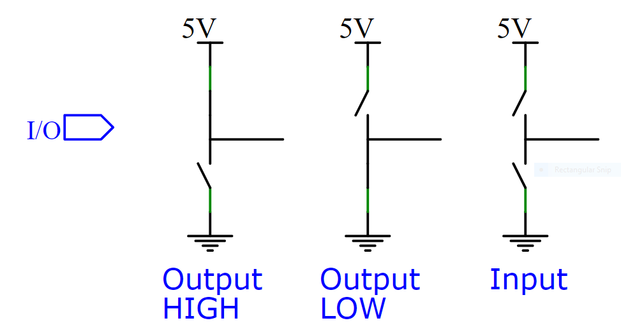
Microcontroller Digital I/O Pin

Slide 4
Digital Input
When used as an input:
Exceptionally low leakage current
UNO processor (ATMEGA348P) specifies <1uA leakage
Actual leakage is much less than 1uA
Close to ideal model
Logic Threshold $V_{T}$:
Varies with supply, temp, device
Stable in the short term
Usually less than half supply
ATMEGA348 specifies $V_{T}$as 1.5-3V on a 5V supply
Works like a comparator to some unknown, slowly changing voltage
High
Low
$$V_{T}$$
Vin

Slide 5
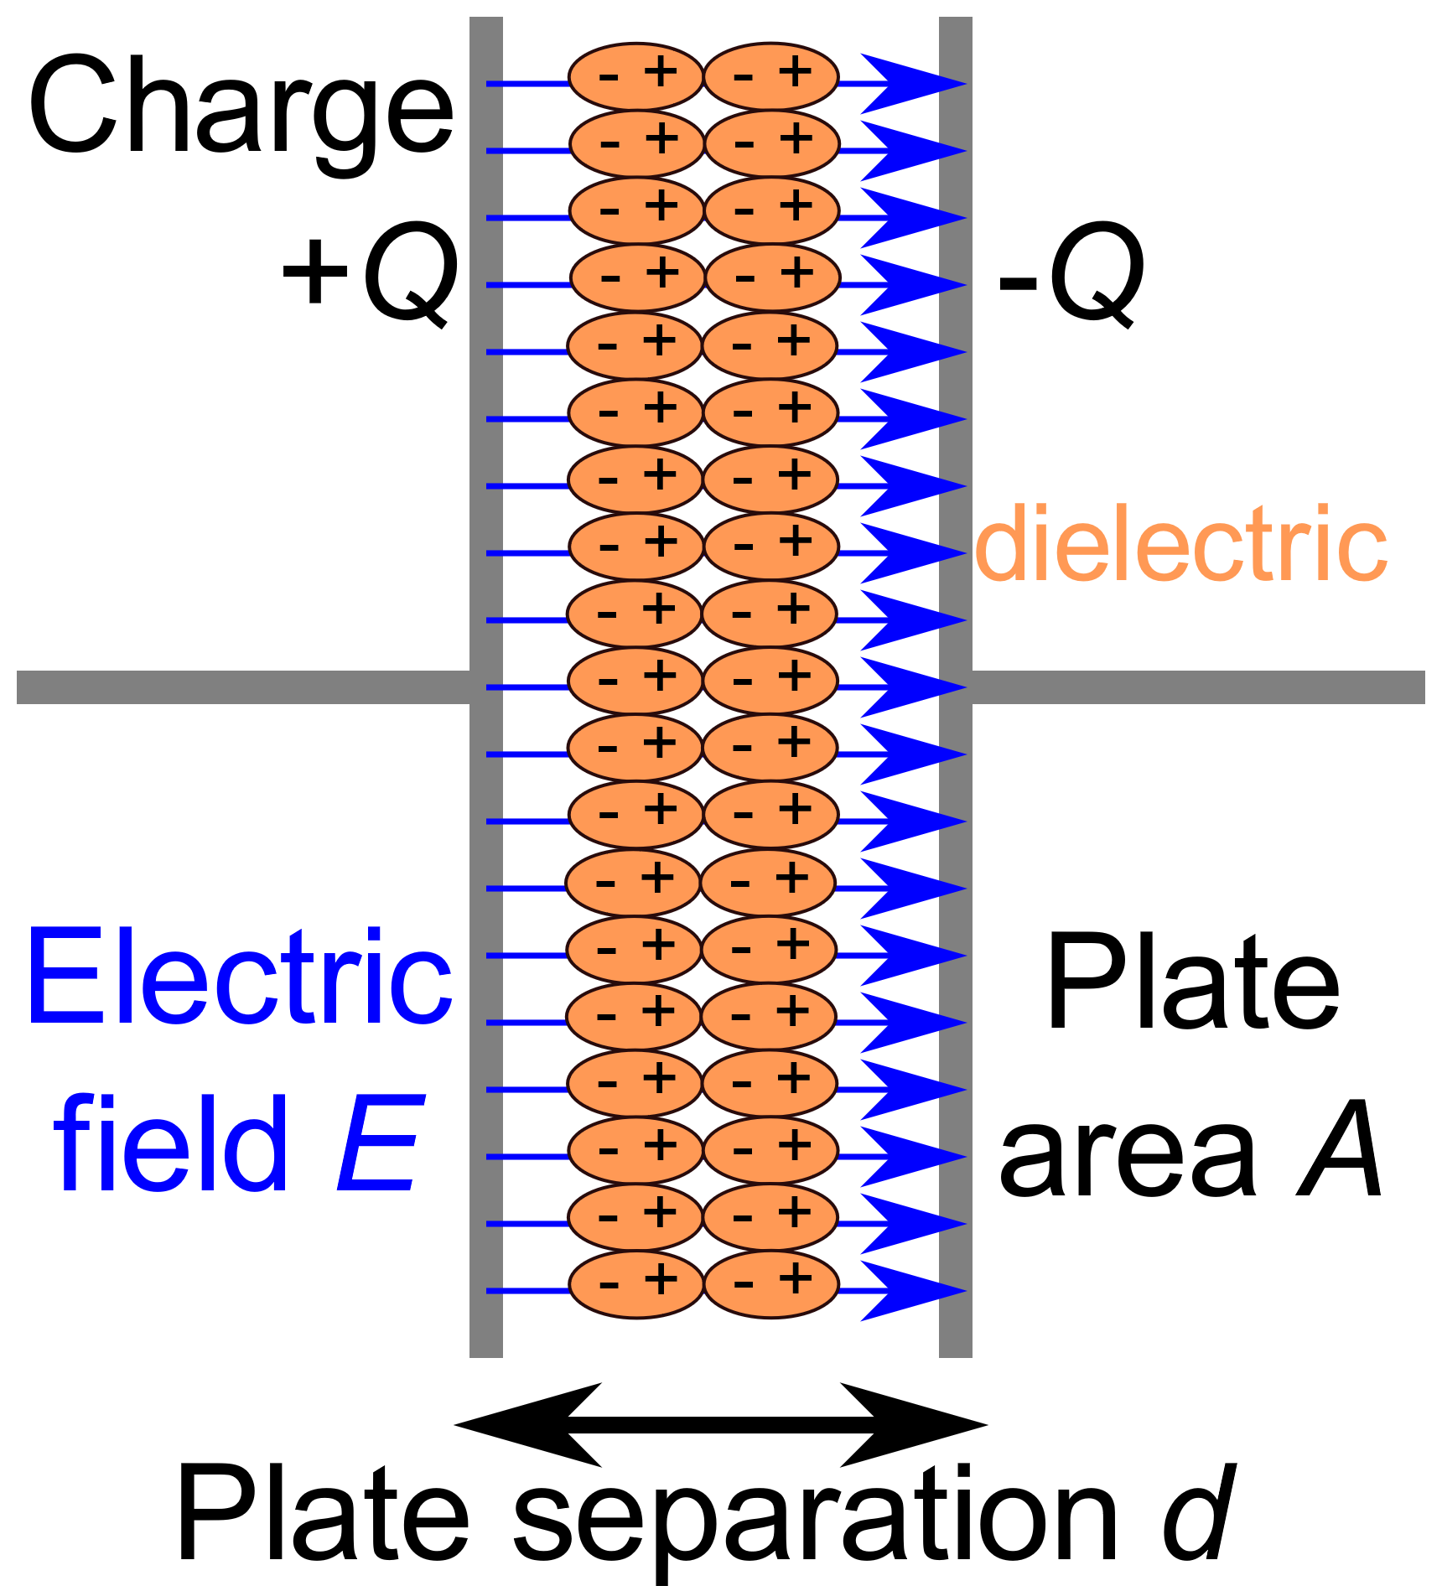
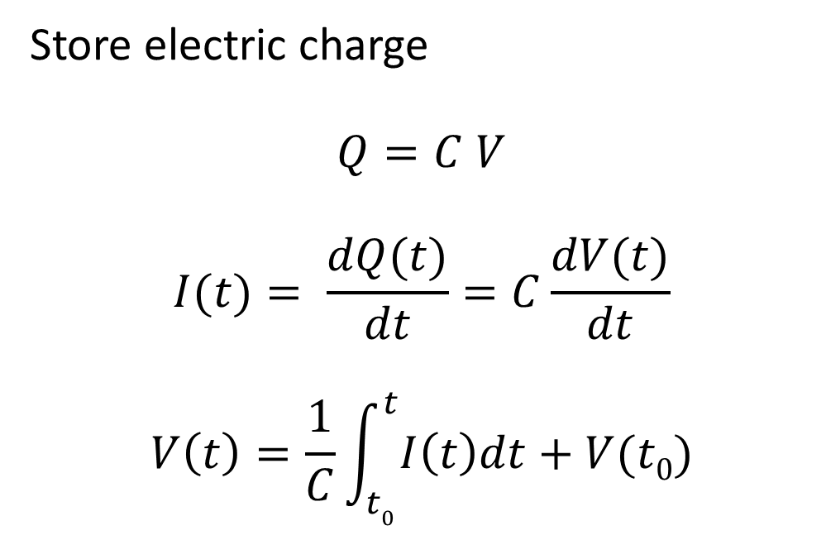
Capacitor Review
Store electric charge
$$Q=C V$$
$$I(t)= \frac{dQ(t)}{dt}=C\frac{dV(t)}{dt}$$
$$V\left(t\right)=\frac{1}{C}\int_{t0}^{t}{I\left(t\right)dt+V(t0)}$$
C=εA/d

Slide 6
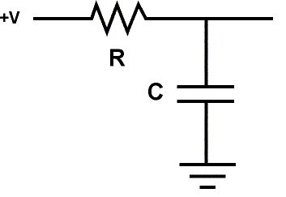
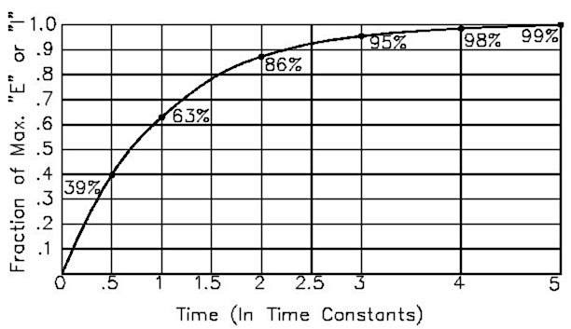
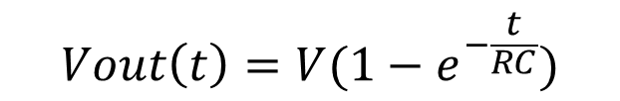
RC Circuits
$$Vout\left(t\right)=V(1−e^{−\frac{t}{RC}})$$
If C is initially discharged, I(0) = V/R
As C charges, rate of increase slows, I(t) = (V – V_{C}(t))/R
Curve is an exponential with a time constant of RC
Charges to ~63% in t=RC
Example: 1MΩ * 1pF = 1μs
Source: https://docs.arduino.cc/tutorials/generic/capacitance-meter

Slide 7
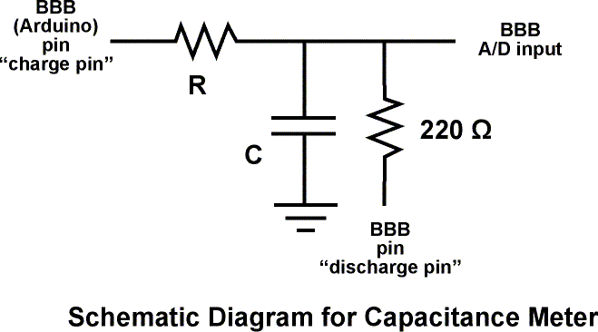
Measuring RC Time Constant with I/O
1 I/O pin to charge through large resistor
1 I/O pin to discharge through small resistor
1 Analog pin to measure the cap voltage
Source: https://docs.arduino.cc/tutorials/generic/capacitance-meter

Slide 8
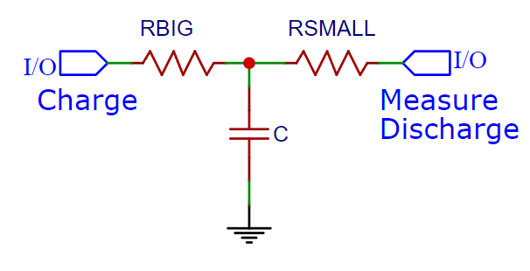
Simplifying the Circuit
No need to discharge and measure at the same time
A relatively small resistor in series with the analog input will have no impact
Use digital input to measure

Slide 9
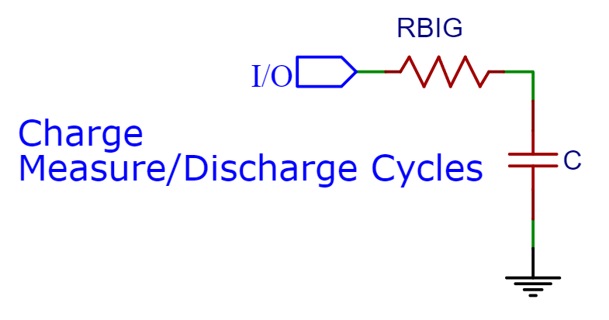
Even Simpler
One Digital I/O Pin!
Discharge a little, then measure
Repeat until done

Slide 10
Human Body Model
A person can be modelled as a capacitor to ground of about ~100pF
Skin resistance varies dramatically. Dry skin typically ~ 100kΩ
Blood and other internal organs can be well modelled as conductors
~100pF

Slide 11
Sensitivity of RC Measurement
Maximum practical resistor is ~10MΩ
Dirt on a printed circuit board can be more conductive than that!
Microcontrollers can easily measure milliseconds
An RC time constant of 1ms with a 10MΩ resistor
C = 10⁻³s/10⁷ Ω = 10⁻¹⁰F = 100pF
This technique can easily measure conductive human touch

Slide 12
Proximity
Most capacitive interfaces have electrodes behind an insulator
Adds another small cap in series. Being near the sense pad may add only 1pF of capacitance to ground!
Time constants are so short with reasonable size resistors that they are difficult to measure accurately
~1pF
RC Example:
C = 10⁻¹²F
R = 1MΩ
RC = 10⁻⁶s
~100pF

Slide 13
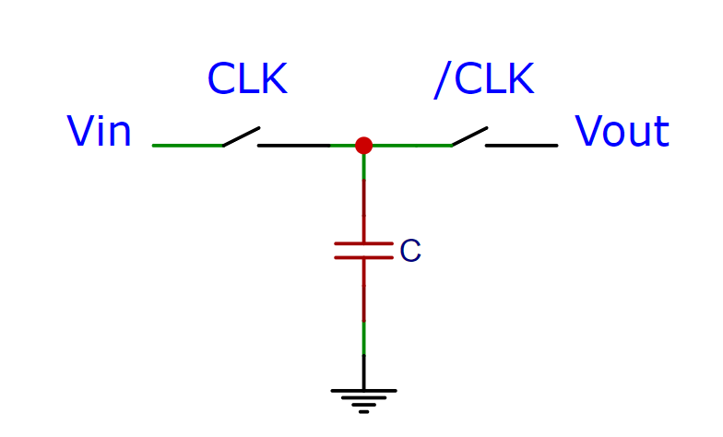
A Switched Capacitor is Like a Resistor
A capacitor with two switches that turn on alternately acts much like a resistor!

Slide 14
Switched Capacitor Analysis
Connected to Vin
Q1 = C Vin
Connected to Vout
Q2 = C Vout
Charge transferred from Vin to Vout
ΔQ = C (Vin – Vout)
Vin
Q1 = C Vin
Vout
Q2 = C Vout

Slide 15
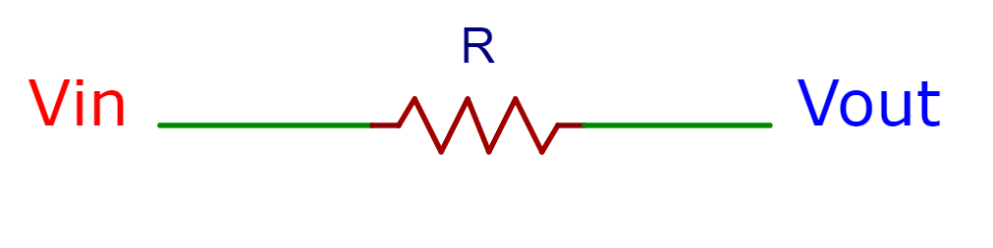
Repeat
f C (Vin – Vout)
Each time the switches cycle
ΔQ = C (Vin – Vout) Coulombs of charge are transferred
Repeating this f times a second gives:
f C (Vin – Vout) Coulombs/sec
Amps are Coulombs per second
A resistor gives a current of
(Vin – Vout)/R
A switched capacitor is much like a discrete time version of a resistor, where R = 1 / (f C)
(Vin – Vout)/R

Slide 16
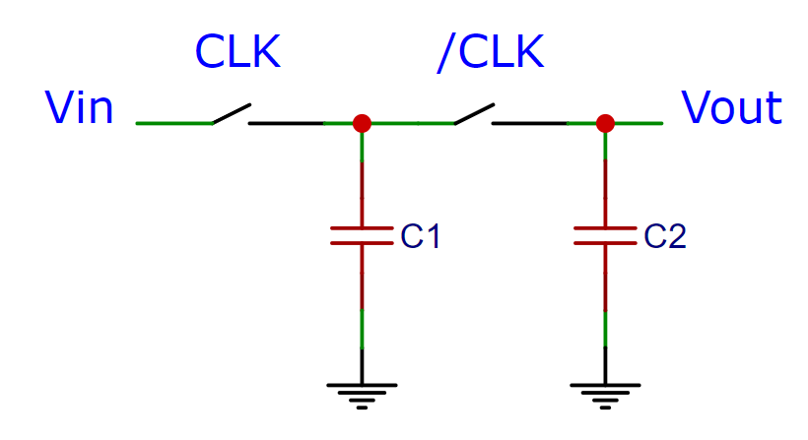
RC with a Switched Capacitor
Assume C2 >> C1
If both caps initially discharged
CLK charges C1 to Vin
On /CLK, charge shares between the two caps
Repeating the cycle charges C2 in steps, heading to Vin

Slide 17
An Analogy
Vin
Ocean
X
X
C1
C2

Slide 18
Implementation: Capacitor Under Test
If C2 >> C1 make the tiny capacitor you are trying to measure C1

Slide 19
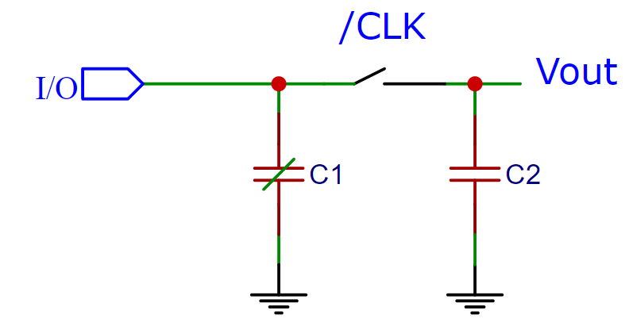
Implementation: The First Switch
Connects to +5V or disconnects
A digital I/O pin can do this!
It can also connect to ground to discharge the cap

Slide 20
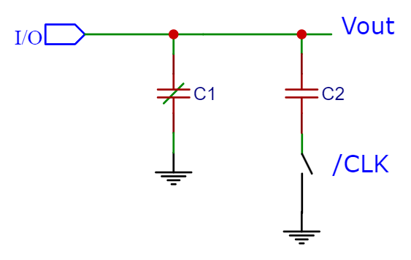
Move the /CLK Switch
The purpose of the second switch is to connect the two caps together. It can be placed anywhere in the loop to break the circuit.

Slide 21
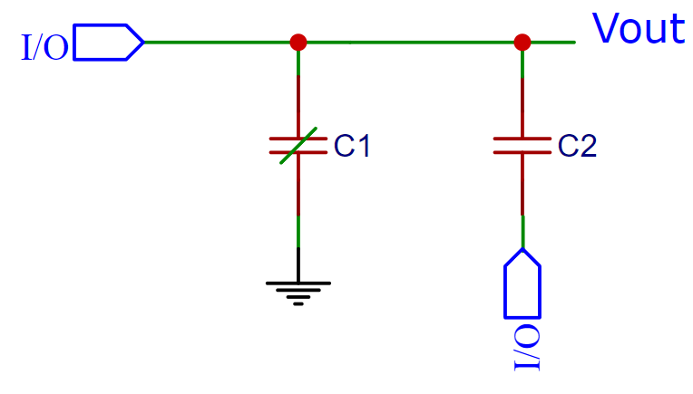
Replace the Second Switch
The second switch either connects to Ground or disconnects. This can also be replaced with a digital I/O pin.

Slide 22
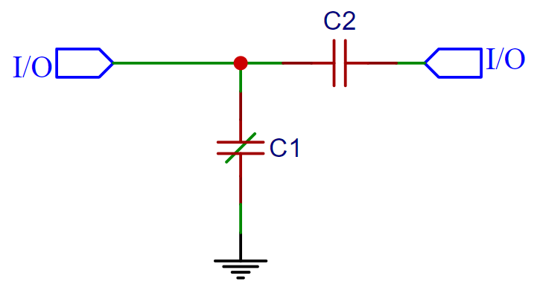
I/O Pin as Input
When an I/O pin is an input, it can tell is voltage is above or below logic threshold. So the pins can measure when they are set as inputs!
C1 is the person! So just a plate to the outside.

Slide 23
Basic Cycle
0: Discharge both caps IO1=GND, IO2=GND
1: Release: IO1 = input, IO2 = input
2: Charge: IO1 = high, IO2 = input
3: Release: IO1 = input, IO2 = input
4: Share: IO1 = input, IO2 = low
Repeat steps 1 through 4 to accumulate charge

Slide 24
Final Trick: Measuring During Charge
When sharing charge, IO1 is input and reads high when C2 has reached the logic threshold
This works as a test, but can be noisy because C1 electrode is also connected to input, picking up noise
Instead, measure when charging C1 using IO2. When C2 has no charge (0V across it) it will read logic high. After sufficient cycles, C2 will charge, making IO2 read low.

Slide 25
Tricks for Implementing on Arduino UNO
digitalRead() and digitalWrite() are very slow!
Use direct port access for speed and simultaneous switching
Pins 8-13 map Port B (5:0)
PORTB access the data output register
DDRB accesses the data direction register (0=input, 1=output)
Turn off input pullup resistors
Setting PUD bit in MCUR disables all pullups
Otherwise, pullup enabled when set to input and output data set to 1
Weird Atmel quirk!

Slide 26
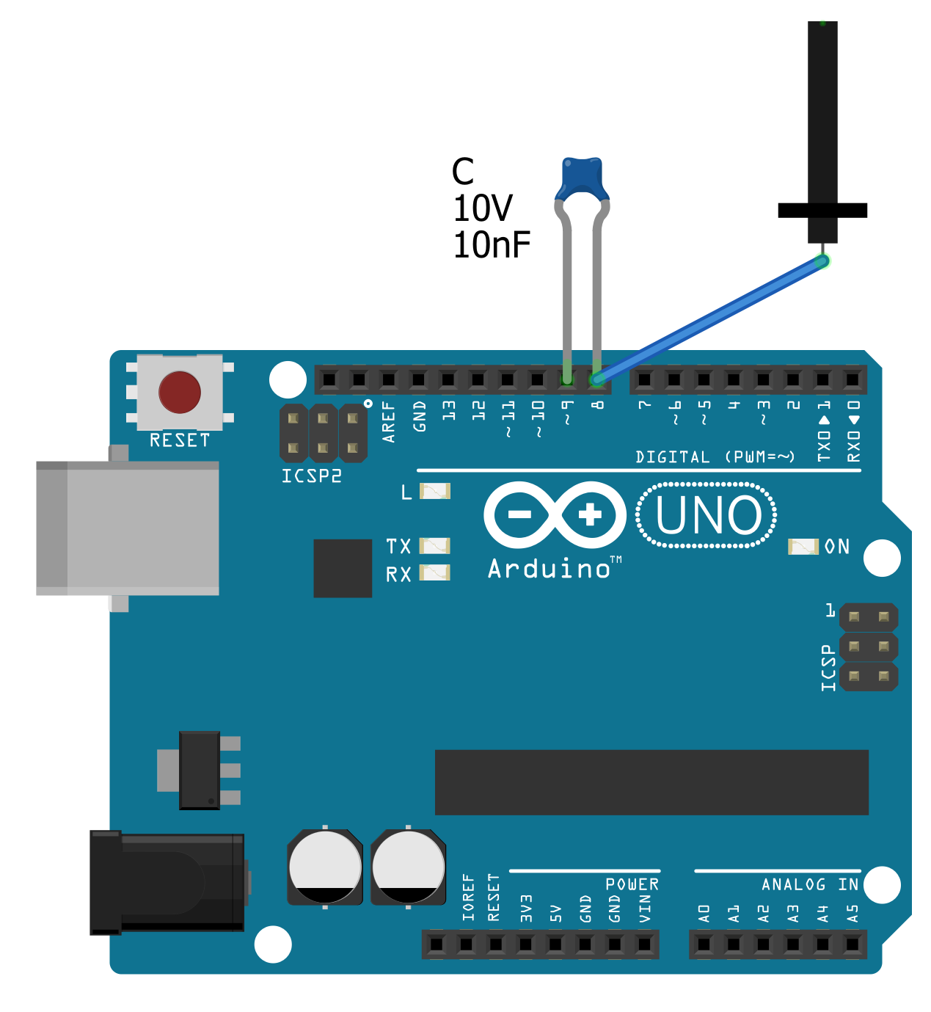
int cap() { int cnt=0;
// Discharge
PORTB = B00000000;
DDRB = B00000011;
delayMicroseconds(10);
// Charge
DDRB = B00000001;
PORTB = B00000001;
while(PINB & B00000010) {
// Release
DDRB = B00000000;
// Share
DDRB = B00000010;
// Release
DDRB = B00000000;
// Charge
DDRB = B00000001; cnt++;
}
return cnt;
}
void setup() {
Serial.begin(250000);
bitSet(MCUCR, PUD); // Disable input pullups
}
void loop() {
Serial.println(cap());
delay(50);
}

Slide 27
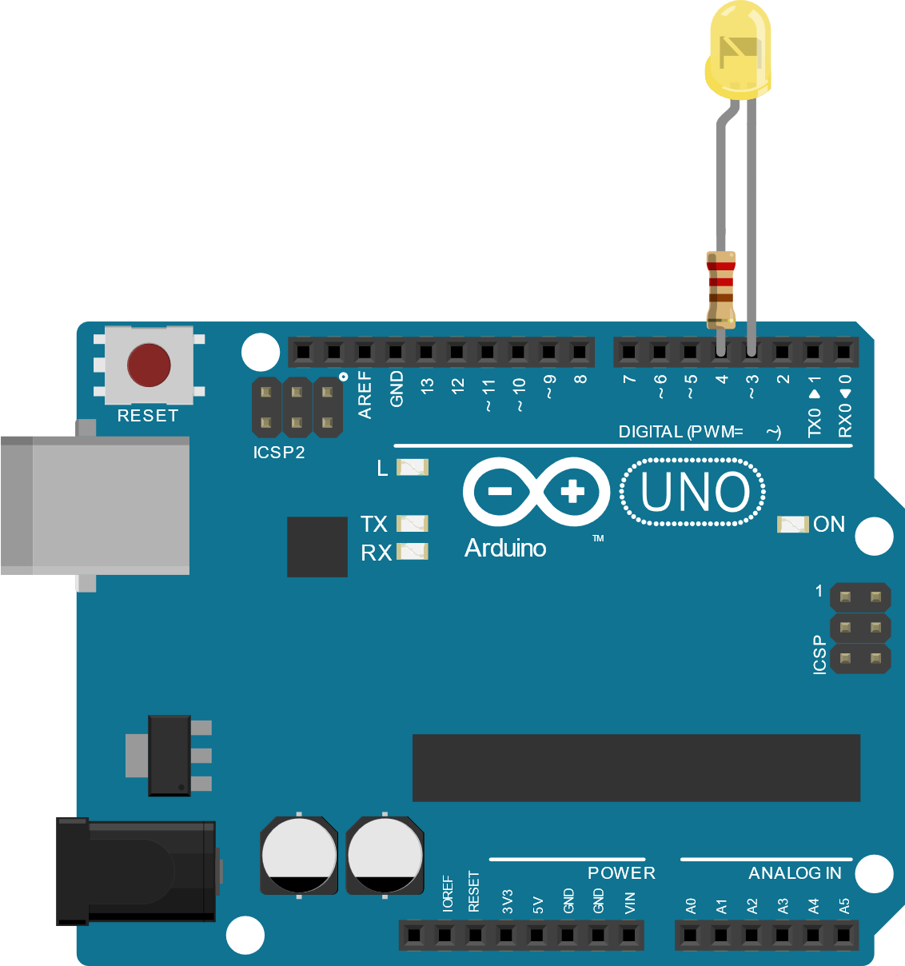
Stay Tuned for More Tiny Circuit Hacks!
LED Tricks using only an Arduino, a resistor and an LED
LED as light emitter
LED as a light sensor
LED as a temperature sensor
LED as a wind sensor

